Slide 1

Designing Microbial Communities Using Interpretable Gaussian Processes
Understanding and Designing Systems with Data

Slide 2
Introduction
Brief overview of the presentation
Importance of understanding and designing systems that generate data
The challenge with traditional machine learning models
Notes:
In this presentation, we will discuss the importance of understanding and designing systems that generate data. We will also touch upon the limitations of traditional machine learning models and how we aim to overcome them.

Slide 3
AI-4-EB Consortium: Project Objectives
Objective 1: Generate a library of stable microbial communities
Objective 2: Developing the Gaussian processes framework for interpretable dynamical system design
Notes:
Our project has two main objectives. First, we aim to develop the Gaussian processes framework for interpretable dynamical system design. Second, we plan to generate a library of stable microbial communities

Slide 4
Expected Outcomes
The project will construct a new library of stable communities to demonstrate the potential of the design approach.
The work will produce an expanded model space of stable communities, serving as an atlas for future biotechnology applications.
The project will provide insights into the design rules of stable communities, such as competition versus cooperation
Notes:
We expect to construct a new library of stable communities and gain insights into the design rules of stable communities. This work will serve as an atlas for future biotechnology applications.

Slide 5
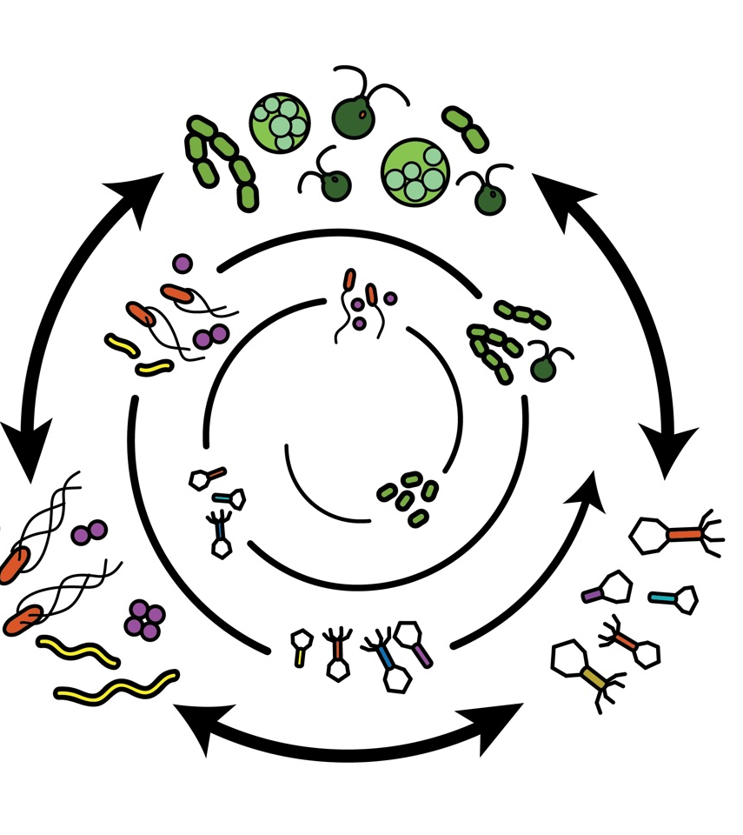

Objective 1: Generate a library of stable microbial communities
What are Microbial Communities?
What Can They Be Used For?
Why Not Monocultures?
Why Stable Communities?
Are Microbial Communities Not Stable?
Notes:
What are Microbial Communities?
Definition and basic characteristics of microbial communities.
What Can They Be Used For?
Applications in biotechnology, medicine, and environmental science.
Why Not Monocultures?
Limitations of monocultures in terms of functional complexity and stability.
Why Stable Communities?
Importance of stability in microbial communities for reliable and effective applications.
Are Microbial Communities Not Stable?
Challenges in naturally occurring microbial communities and the need for engineered stability.

Slide 6




What are synthetic genetic circuits and what can they be used for?

Slide 7
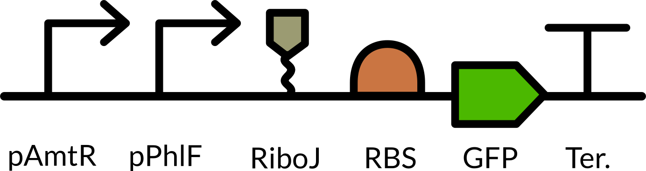
What are synthetic genetic circuits and what can they be used for?

Slide 8



What are synthetic genetic circuits and what can they be used for?

Slide 9

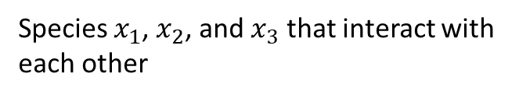


What are synthetic microbial communities?
$$x_{1}$$
$$x_{2}$$
Intentionally designed and assembled microbial communities with a specific composition and purpose in mind
$$x_{3}$$
Species $x_{1}$, $x_{2}$, and $x_{3}$ that interact with each other

Slide 10
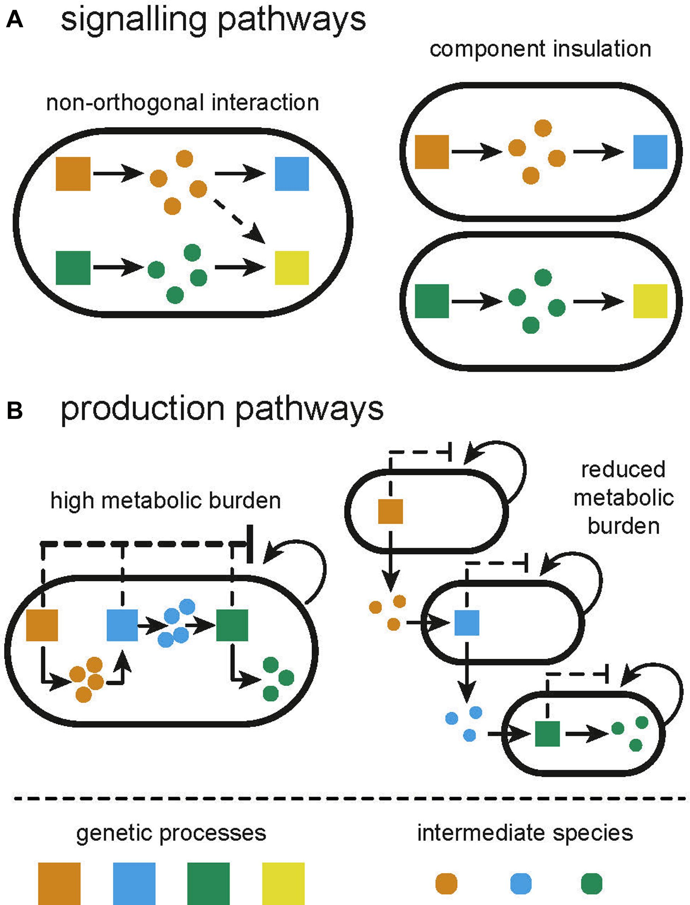
Why not monocultures? Why stable communities?
B. D. Karkaria, N. J. Treloar, C. P. Barnes, and A. J. H. Fedorec, “From Microbial Communities to Distributed Computing Systems,” Front. Bioeng. Biotechnol., vol. 8, 2020, doi: 10.3389/fbioe.2020.00834.
Notes:
- Division of Labor
- Chemical Synthesis of complex
- Less error prone (talk about hazards)

Slide 11
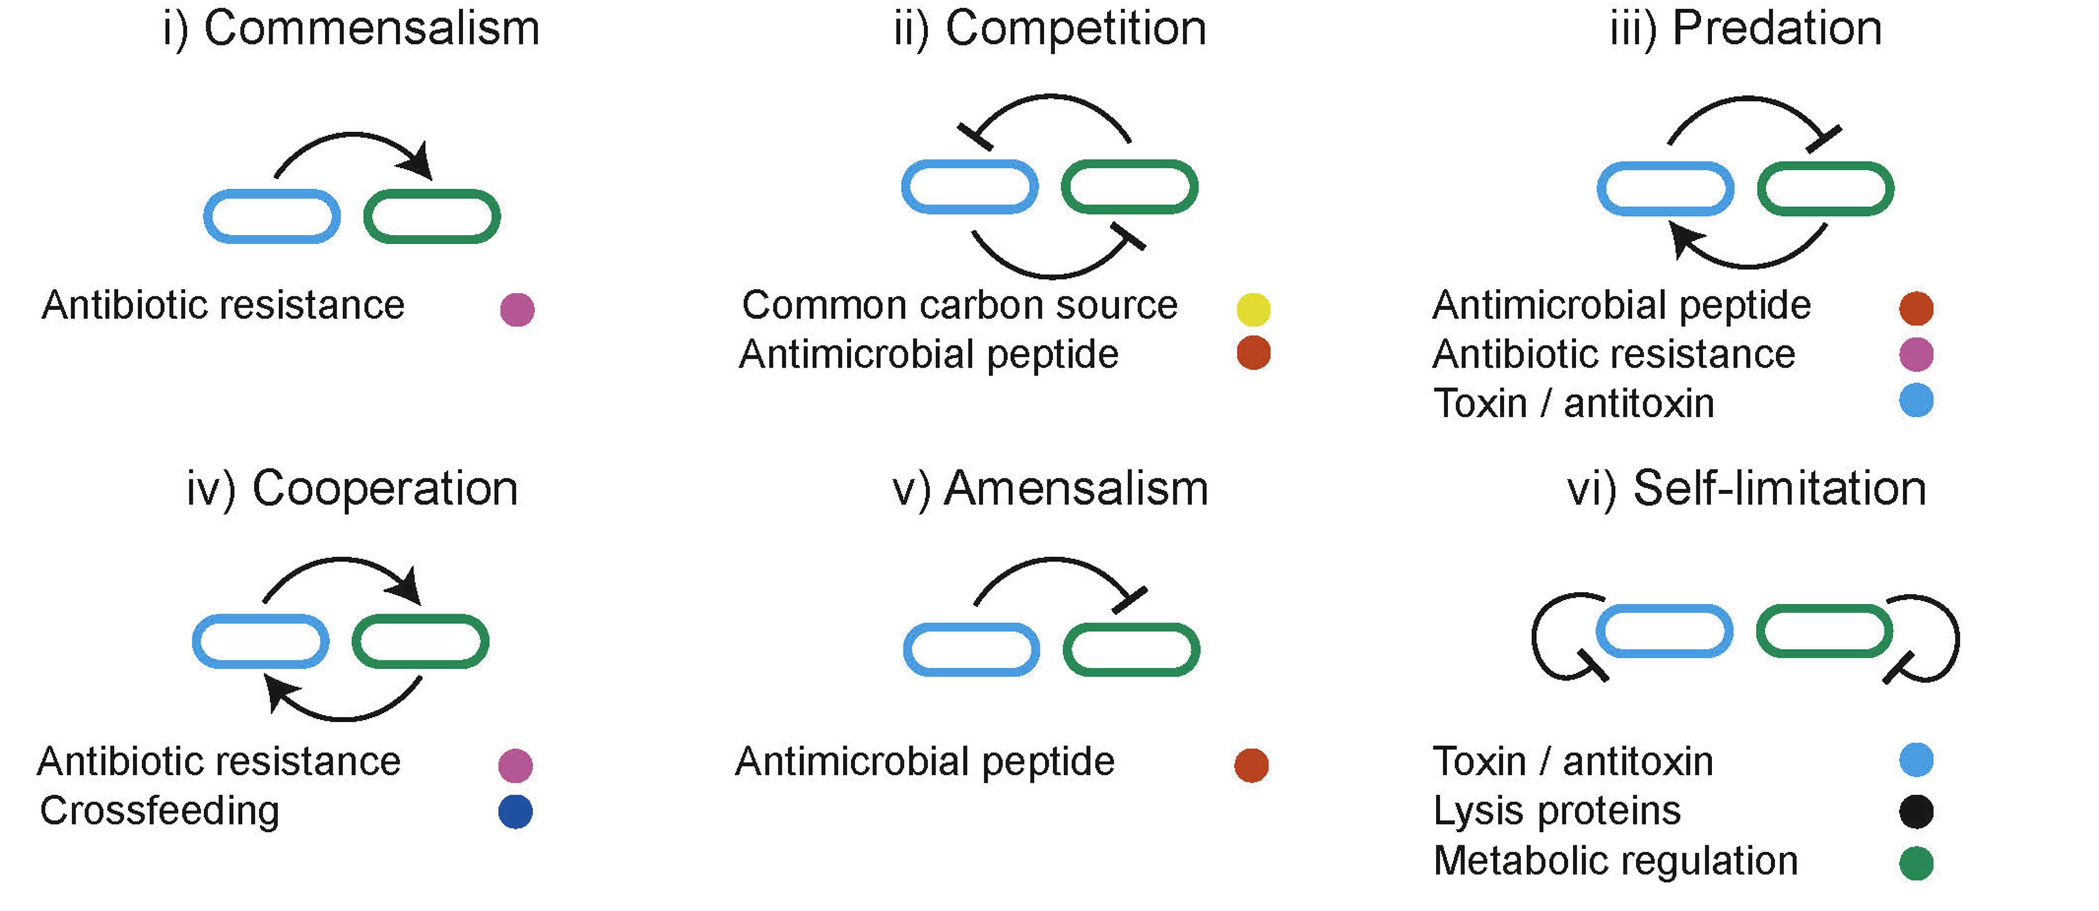
Ecological interactions used to dynamically manipulate resource allocation within co-cultures
B. D. Karkaria, N. J. Treloar, C. P. Barnes, and A. J. H. Fedorec, “From Microbial Communities to Distributed Computing Systems,” Front. Bioeng. Biotechnol., vol. 8, 2020, doi: 10.3389/fbioe.2020.00834.

Slide 12
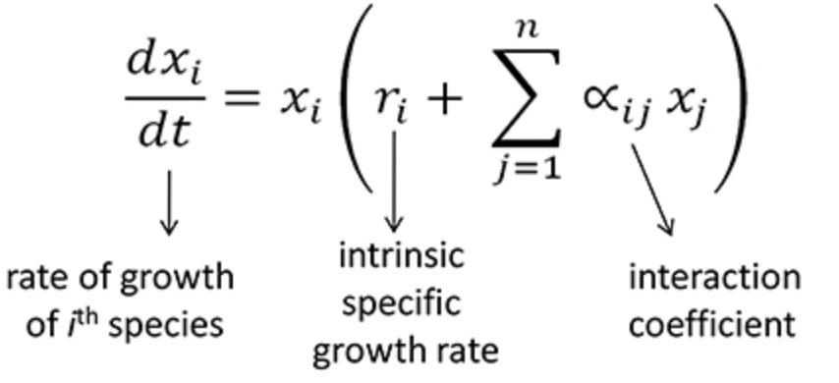
The model
$$x_{1}$$
$$x_{2}$$
$$x_{3}$$
Generalized Lotka-Volterra model

Slide 13
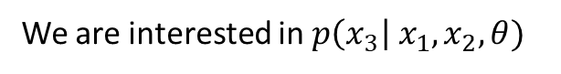
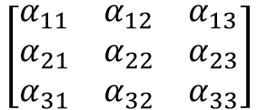

The model
$$x_{1}$$
$$x_{2}$$
$$x_{3}$$
$$\left[\begin{matrix}α_{11} & α_{12} & α_{13} \\ α_{21} & α_{22} & α_{23} \\ α_{31} & α_{32} & α_{33}\end{matrix}\right]$$
We are interested in $p\left(x_{3}\right| x_{1},x_{2}, θ)$

Slide 14
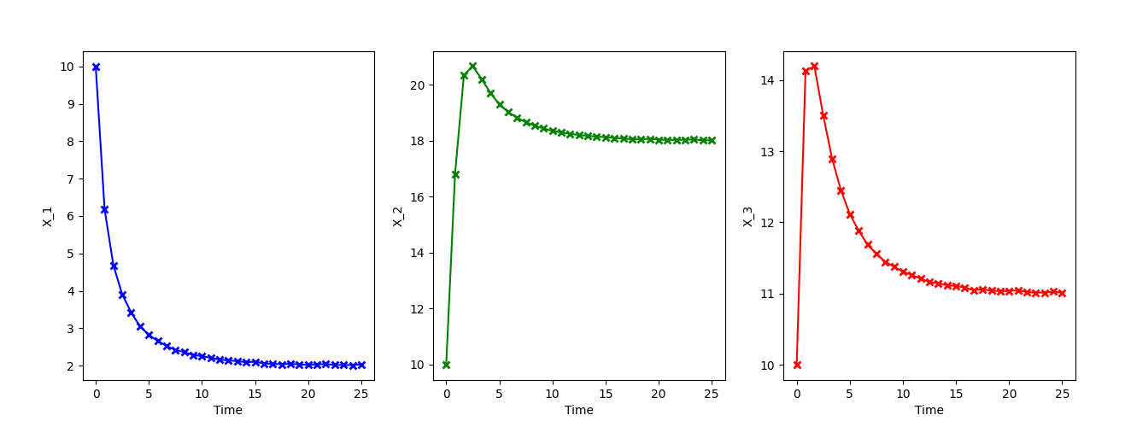
The simulation of Generalized Lotka-Volterra model
Notes:
However, time-series data of the steady state display little about its underlying dynamics, which is a bad scenario for system identification. To excite the system and get “richer” or more informative timeseries data, we apply external perturbations to drive the system and measure its response.

Slide 15
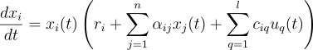
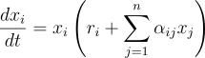



Extended Generalized Lotka-Volterra model (gMLV)
Includes external perturbations
$$x_{1}$$
$$x_{2}$$
$$x_{3}$$

Slide 16
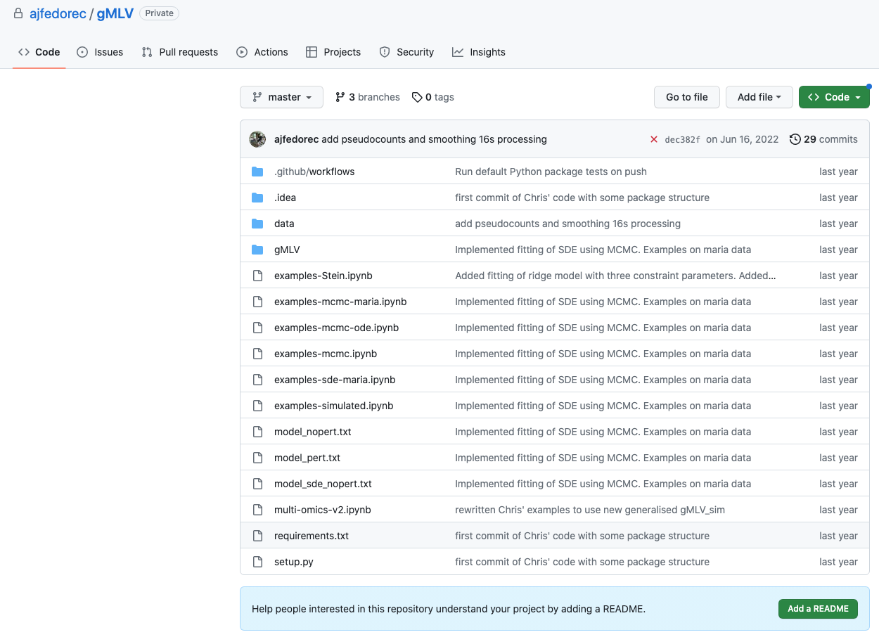
Extended Generalized Lotka-Volterra model (gMLV)
Software package: gMLV
Simulation and inference methods for microbial communities

Slide 17
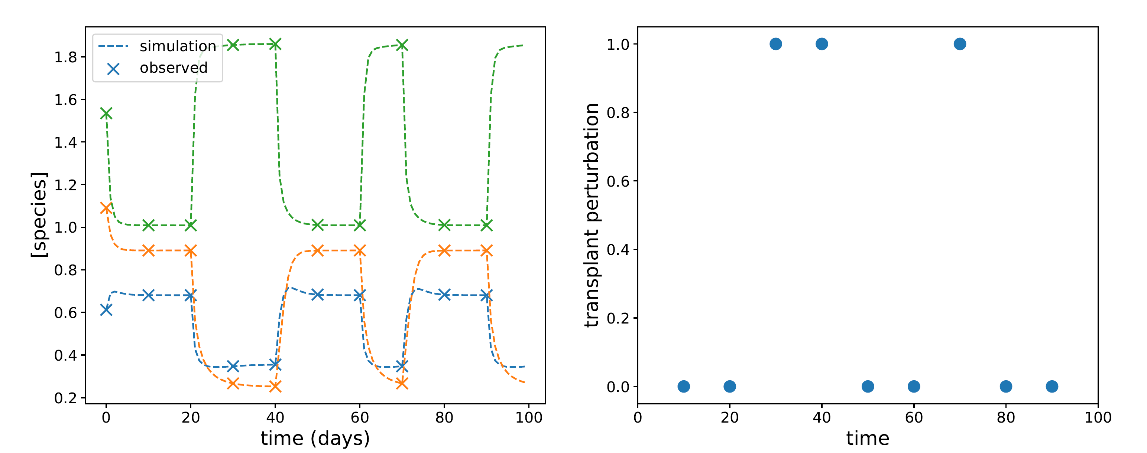
Simulation results of the Extended Generalized Lotka-Volterra model

Slide 18
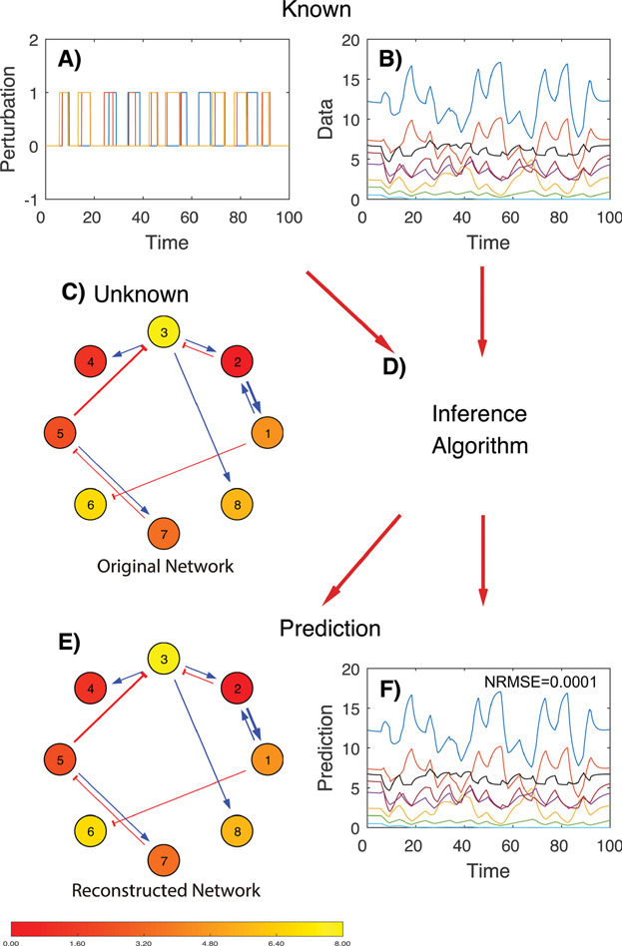
Design
Design stable synthetic bacterial communities
H.-T. Cao, T. E. Gibson, A. Bashan, and Y.-Y. Liu, “Inferring human microbial dynamics from temporal metagenomics data: Pitfalls and lessons,” BioEssays, vol. 39, no. 2, p. 1600188, 2017, doi: 10.1002/bies.201600188.

Slide 19
Objective 1: Generate a library of stable microbial communities
Comprehensive Research Resource for Future Projects
Enhanced Predictability in Microbial Behavior
Direct and Interpretable Community Design Methods
Fostering Cross-Disciplinary Research Synergy
Setting New Standards for Biotechnological Applications
Advantages of Producing a Library of Stable Microbial Communities
Notes:
1. Comprehensive Research Resource for Future Projects
A comprehensive library of stable microbial communities serves as a valuable resource for researchers, reducing the time and effort required to initiate new projects.
2. Predictable Behaviors
Engineered stability ensures that microbial communities behave in a predictable manner, increasing the reliability and effectiveness of their applications in various fields.
3. Direct and Interpretable Community Design Methods
The library addresses the limitations of existing methods, such as Recurrent Neural Networks (RNNs), by offering a more direct and interpretable approach to community design
4. Fostering Cross-Disciplinary Research Synergy
The project brings together experts from physics, control theory, and statistics, fostering interdisciplinary collaboration that enriches the research and leads to more robust solutions.
5. Setting New Standards for Biotechnological Applications
The creation of a stable microbial community library has the potential to revolutionize microbial engineering, setting new standards for stability and functionality in biotechnological applications.

Slide 20

Objective 2: Developing the Gaussian processes framework for interpretable dynamical system design

Slide 21
Machine Learning and Its Limitations
Explanation of how machine learning works
Emphasize on its predictive capabilities
Discuss its limitations: lack of interpretability, inability to understand underlying interactions or structures, and not suitable for designing systems with specific outcomes
Talk about to design microbial communities, we need a good model that can predict the types of interactions that are within the community that produce the data
Notes:
Machine learning is a powerful tool for predicting data. However, its models, while complex and accurate, do not provide us with an understanding of the underlying interactions or structures that generate the data. Furthermore, they are not suitable for designing systems with specific outcomes.

Slide 22
Gaussian Processes: An Overview
Definition and explanation of Gaussian processes
How Gaussian processes differ from traditional machine learning models
The balance Gaussian processes strike between capturing complex behaviours and being directly interpretable
Talk about that the first step is to create a model that:
1) predicts or fits to the data well and,
2) is interpretable, so we can understand what the underlying network is
Notes:
Gaussian processes provide a robust method for modelling non-linear functions in a Bayesian nonparametric framework. Unlike traditional machine learning models, they strike a balance between capturing complex behaviours and being directly interpretable

Slide 23
Gaussian Processes for System Identification
How Gaussian processes can be used to understand a system that generates data
Explanation of how Gaussian processes model non-linear functions in a Bayesian nonparametric framework
Discuss examples of how Gaussian processes have been used to learn ordinary differential equation (ODE) models
Notes:
We can use Gaussian processes to understand a system that generates data. By learning ordinary differential equation models, we can gain insights into the system's behaviour and interactions

Slide 24
Show image that describes the difference between machine learning and GP!
Machine learning is great at predicting data. It does so from learning from data and generating a very complex, albeit non-interpretable, model to be able to predict regressions or classifications with great accuracy. However, these models only use case is to predict new values, but it is not good to understand the underlying interactions or structures that generated the data itself. Furthermore, if we want to use the models to designs systems with specific outcomes, classical machine learning isn't useful. In this project, we will try two things: generate gaussian processes models to accurately model microbial communities interactions and predict their stability, but at the same time also use these models to be able to design even more stable communities. We will do so by decomposing the kernels into simple kernels that are easier to interpret.

Slide 25
Gaussian Processes for System Design
Explanation of how Gaussian processes can be used to design more stable microbial communities
Discuss the concept of vector valued Gaussian processes to capture multidimensional design constraints
Explain how finding the covariance structure of the Gaussian processes that best fits the design objectives can infer how to construct the microbial community to achieve the desired behaviour
Notes:
Gaussian processes can also be used to design more stable microbial communities. By fitting vector valued Gaussian processes, we can capture multidimensional design constraints and infer how to construct the microbial community to achieve the desired behaviour.

Slide 26
Steps to Achieve the End Goals
Step 1: Develop the GP Framework
Adapt Gaussian Processes (GPs) for interpretable dynamical system design.
Use vector-valued GPs to capture multidimensional design constraints.
Infer how to construct the microbial community to achieve the desired behavior.
Step 2: Generate a Library of Stable Communities
Extend previous work on communities incorporating intercellular communication and bacteriocins.
Collaborate with Syngulon, a synthetic biology start-up, for access to their library of bacteriocins.
Engineer E. coli strains to create a modular community library.
Step 3: Test Predictions
Use automated approaches in the London Biofoundry to combine strains in a high-throughput manner.
Validate the design approach by testing the predictions.

Slide 27

Proposed Research Methodology
Create Synthetic Data via Lokta-Volterra Models
Generate controlled data for microbial communities to know the actual parameter values for our model.
Implement Gaussian Process (GP) Prediction Script
Develop a script using GPs to accurately forecast the synthetic time-series data.
Integrate GP with ODE Solution Space
Constrain the GP model within the solution space of our Ordinary Differential Equation (ODE) model to ensure compatibility.
Apply Kernel Search for Unknown Systems
Extend the methodology to systems with unknown underlying dynamics using a kernel search, similar to the automatic statistician approach. We can restrict search to certain mean functions + kernels that conform to increasingly general ODE solutions so we retain interpretability
Validate Methodology with Real Experimental Data
Test the developed methodologies using actual experimental results to confirm their applicability.
Design Stable Microbial Communities
Apply the validated methodology to engineer stable microbial communities.

Slide 28
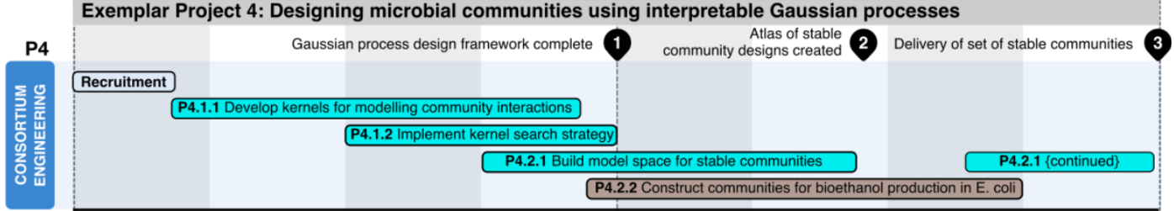
AI4 grant: Project Objectives and Deliverables
Objective 1: Develop the GP framework for interpretable dynamical system design.
Objective 2: Generate a library of stable microbial communities for bioethanol production.
PDRA time: 01.04.22 – 31.01.2024 (22 months)

Slide 29
First Steps
1) Develop a synthetic data generation script
3) Utilize synthetic data to train Gaussian Process (GP) model selection
Notes:
Our next steps involves the creation of synthetic data. Synthetic data will help us generate ample data to train our Gaussian Process models and give us a deeper understanding of the intrinsic relationships between different species in our study. This understanding can be used as a benchmark when we begin deploying GPs to interpret the systems.
Key Benefits of the Approach:
Accelerate the GP model training process
Facilitate a better understanding of underlying systems
Enable comprehensive comparison and matching of GPs with the "true" system
This approach will not only streamline and expedite the GP model training process but will also facilitate a more profound understanding of the underlying systems that generate the data. Moreover, it will provide us with the ability to compare and match our Gaussian Process understanding with the actual or "true" system in a comprehensive manner.
-----------------------------------
Produce a script to generate synthetic data. This will not only help us produce a lot of data to which train our gaussian processes models, but also know what is the “true” or “real” underlying relationship between species that generate the data. So when we start to use GPs to understand the underlying systems we can match and compare.
Produce a script to automatically generate the best GP regression that loops for these different variables: different kernels, different latent processes, etc

Slide 30
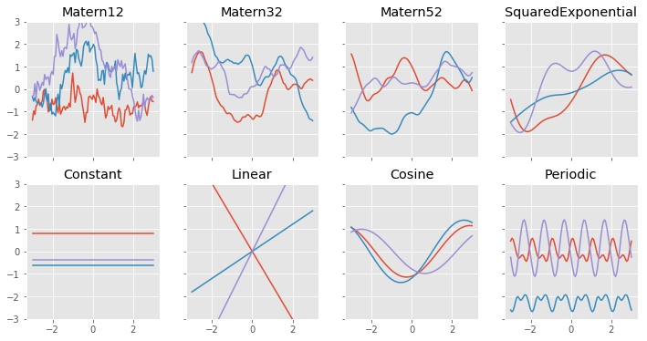
Gaussian Processes Script
Create an automated script to generate the best GP fit using kernel space exploration and dimensions
Loop through different variables: models, kernels, latent processes, and mean functions
First, through base kernels, then through combinations (by addition and/or multiplication) of kernels [1-3]
Possibly also loop through different likelihoods
Notes:
We will automate the process of GP regression model generation. This script will enable us to iterate through various parameters, such as different kernels and latent processes, to generate the optimal GP regression for our needs.

Slide 31
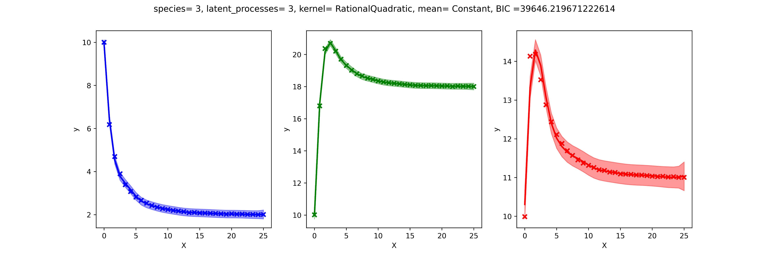
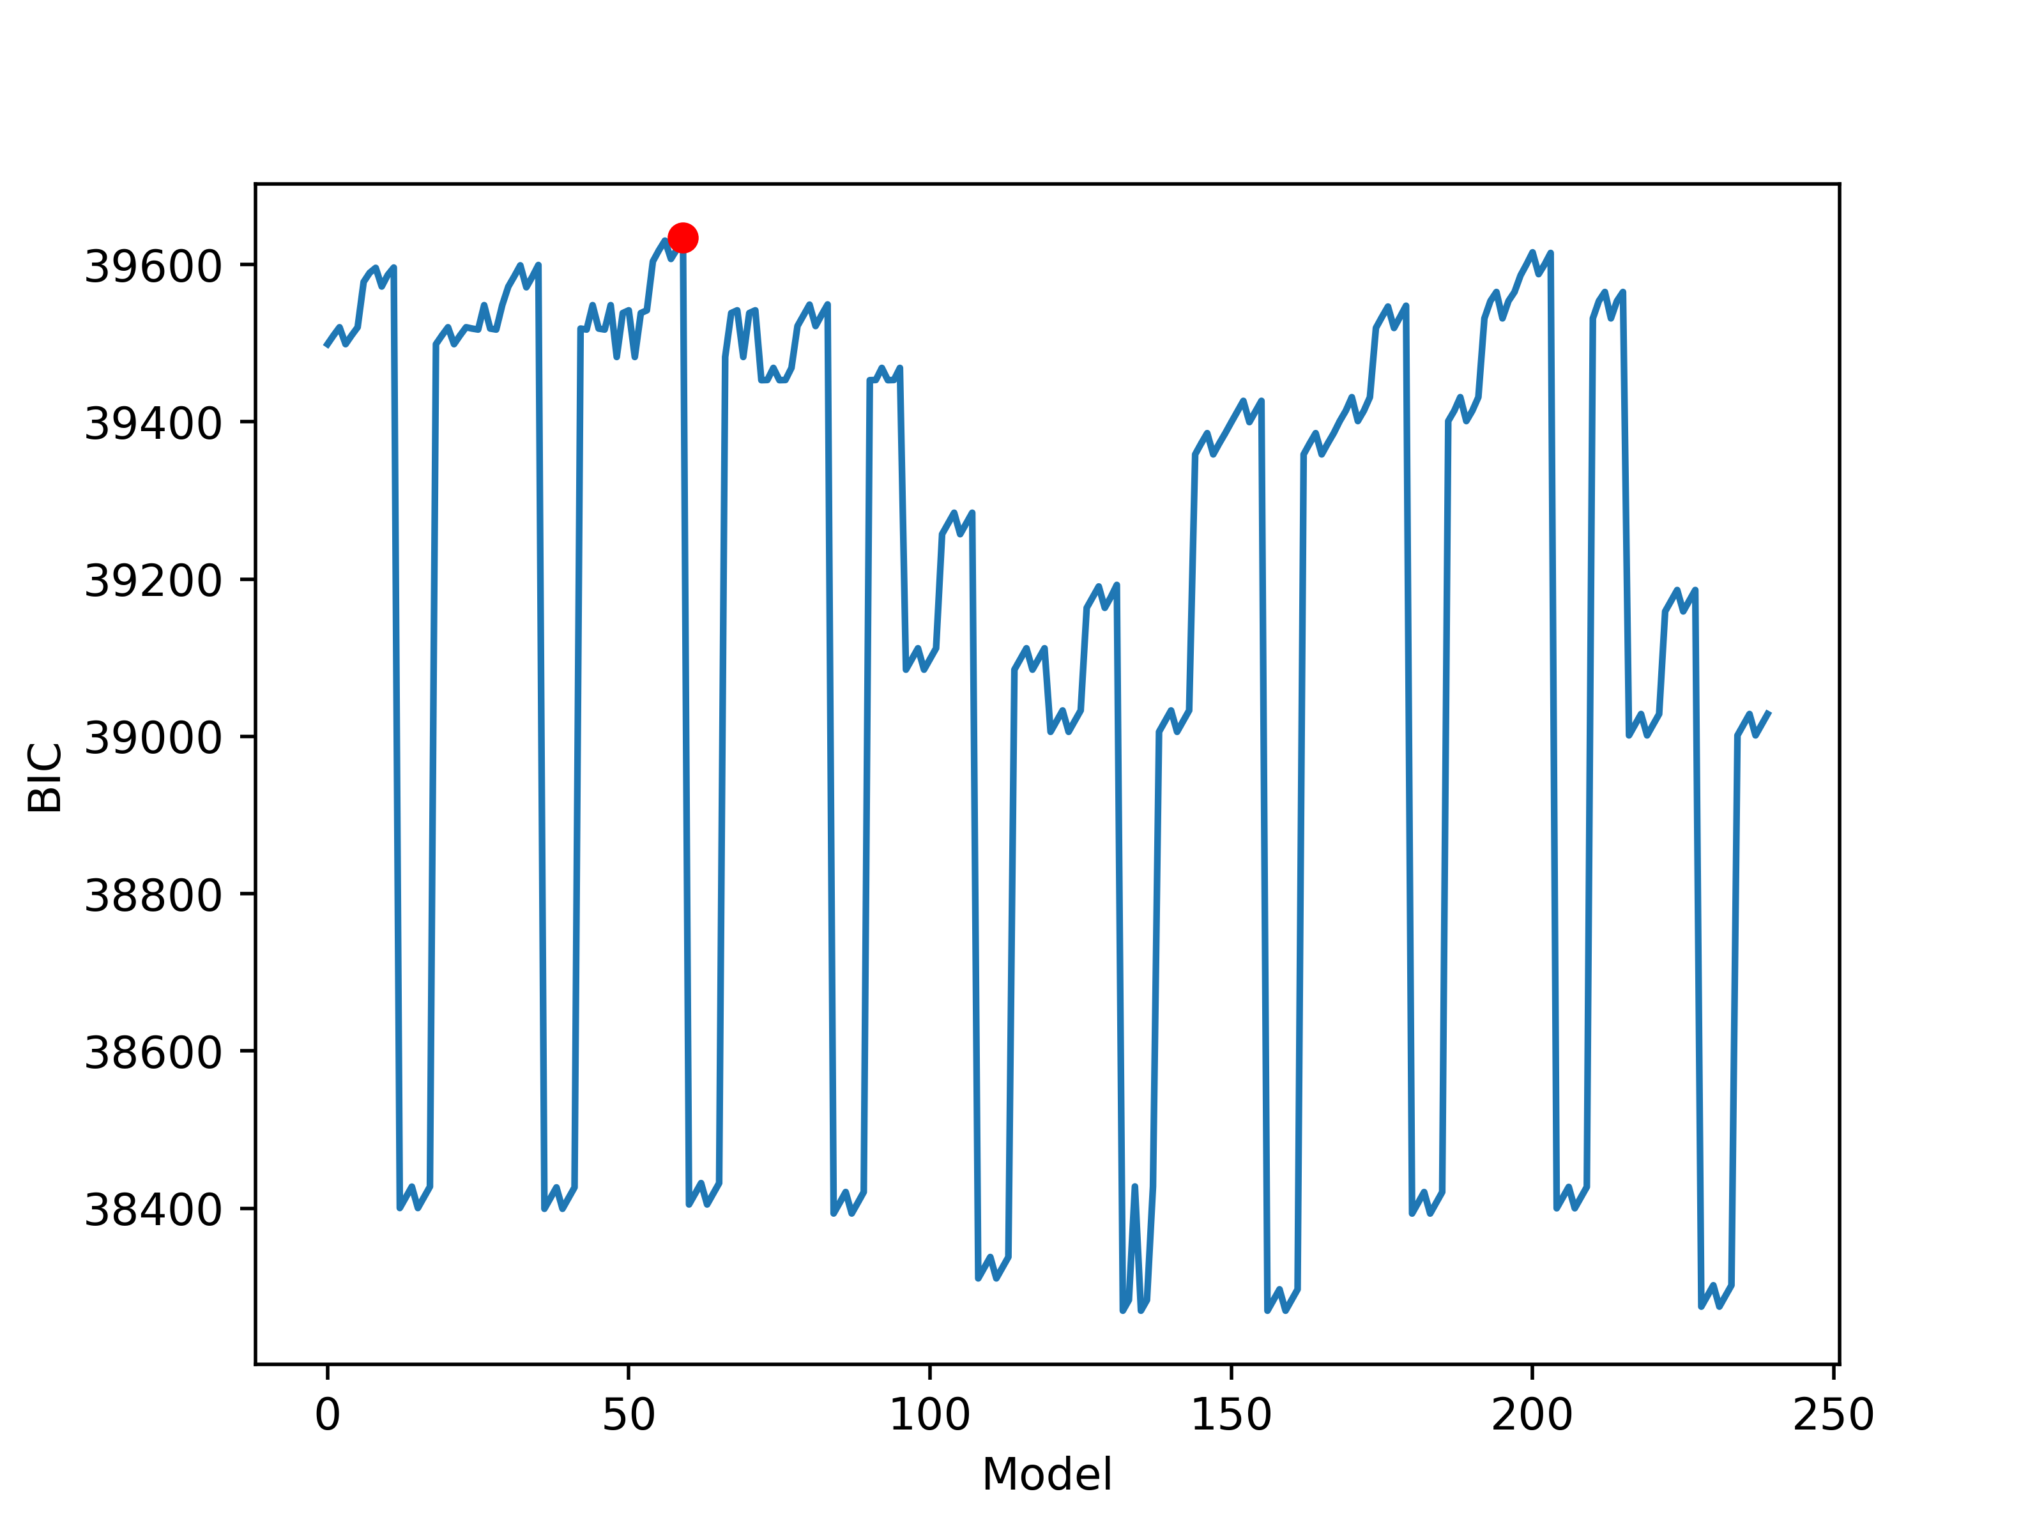
Initial Results

Slide 32
Kernel List
gpf.kernels.SquaredExponential, gpf.kernels.Matern32, gpf.kernels.RationalQuadratic, gpf.kernels.Exponential,
gpf.kernels.Linear,
gpf.kernels.Cosine,
gpf.kernels.Periodic,
gpf.kernels.Polynomial,
gpf.kernels.Matern12,
gpf.kernels.Matern52,
gpf.kernels.White

Slide 33
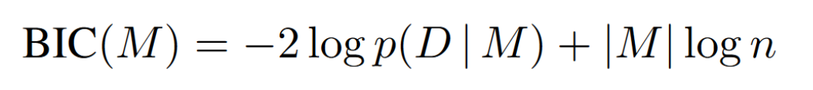
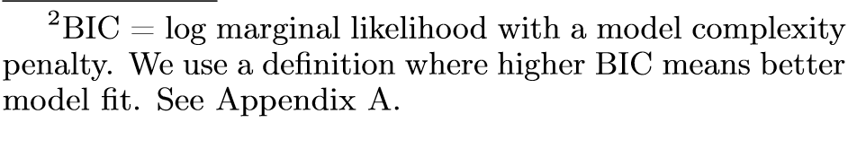
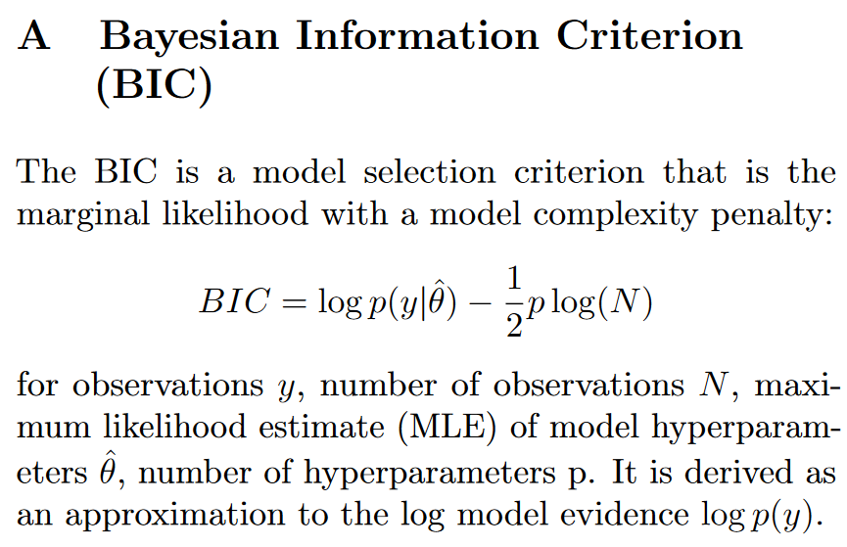
Scoring Models (alternative to BIC?) – LML, CLML, or other
BIC loss
Conditional LML: namely, we show how marginal likelihood can be negatively correlated with generalization, with implications for neural architecture search, and can lead to both underfitting and overfitting in hyperparameter learning. We provide a partial remedy through a conditional marginal likelihood, which we show is more aligned with generalization, and practically valuable for large-scale hyperparameter learning, such as in deep kernel learning. [1]
[1] Lotfi, S.; Izmailov, P.; Benton, G.; Goldblum, M.; Wilson, A. G. Bayesian Model Selection, the Marginal Likelihood, and Generalization. In Proceedings of the 39th International Conference on Machine Learning; PMLR, 2022; pp 14223–14247.

Slide 34
Simulated General Lokta-Volterra using gLMV

Slide 35
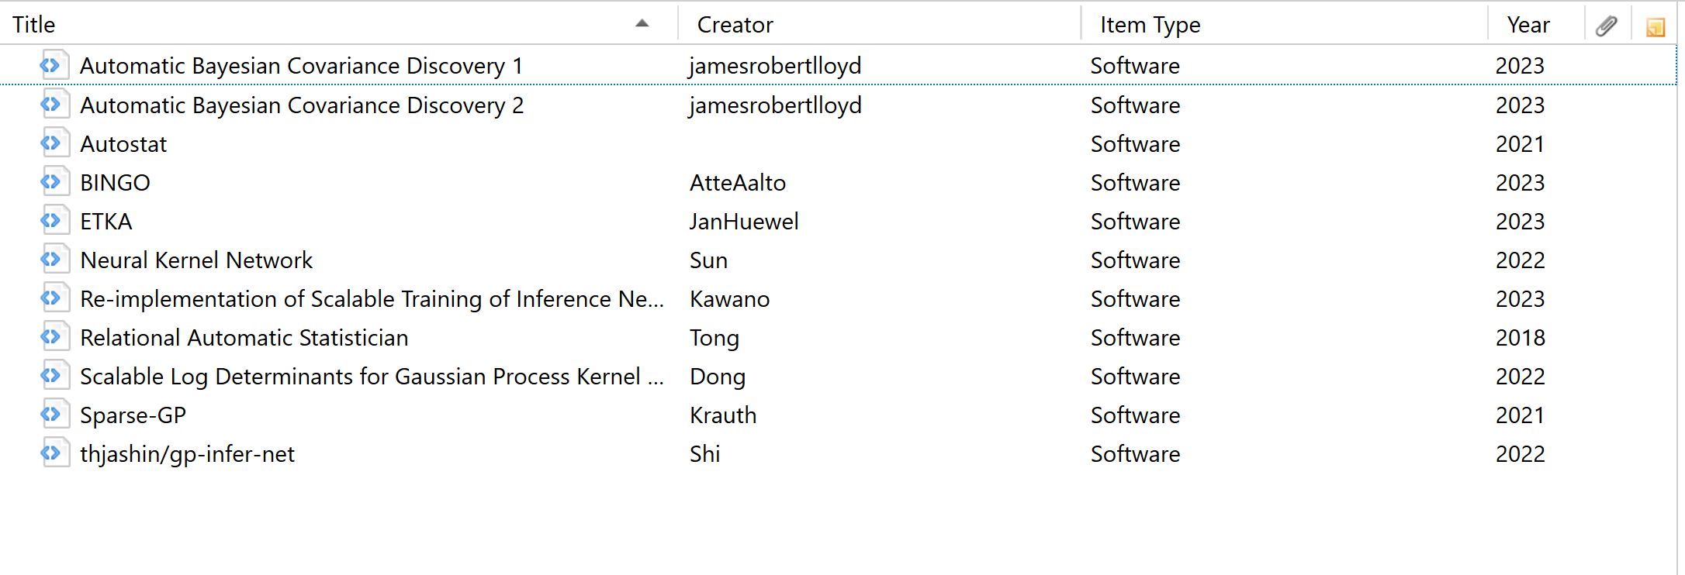
Search for working/recently-updated forks of the many GitHub repositories related to the Automated Statistician.

Slide 36
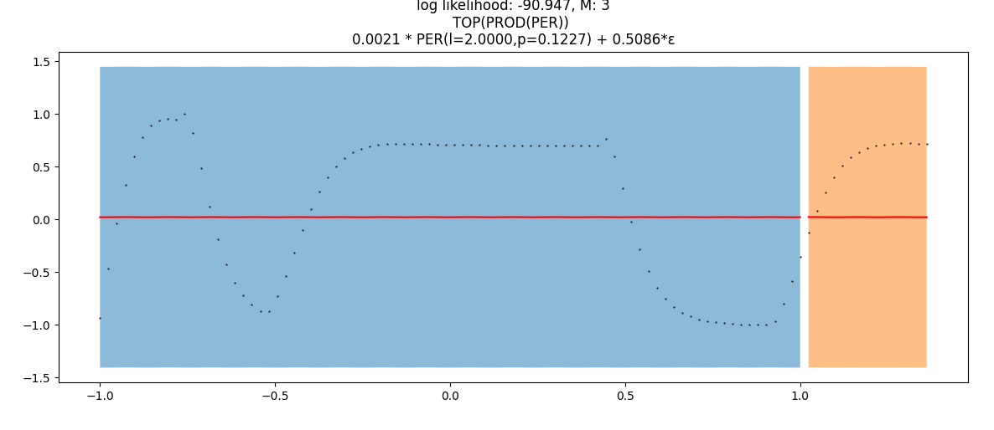
Autostat generated kernels
Lvl 1

Slide 37
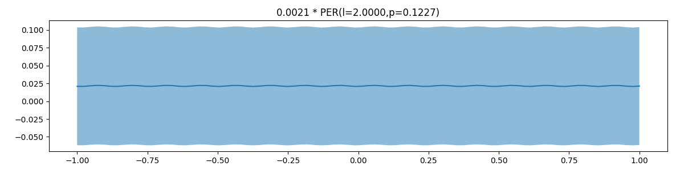
Autostat generated kernels
Lvl 1

Slide 38
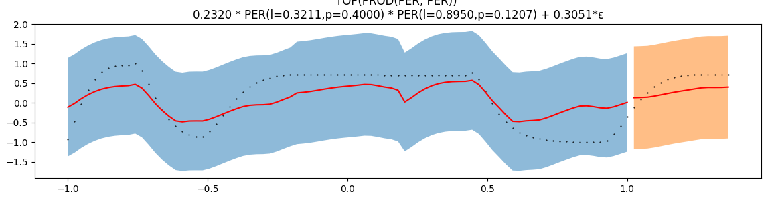
Autostat generated kernels
Lvl 2

Slide 39
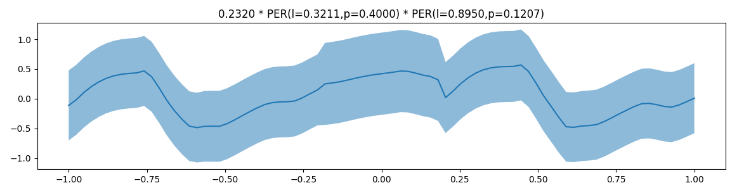
Autostat generated kernels
Lvl 2

Slide 40
Autostat generated kernels
…
Lvl 3,4,5

Slide 41
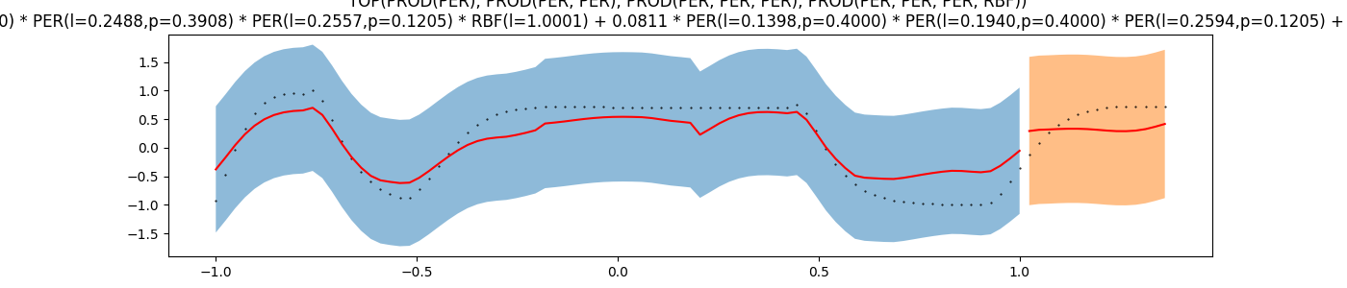
Autostat generated kernels
Lvl 6

Slide 42
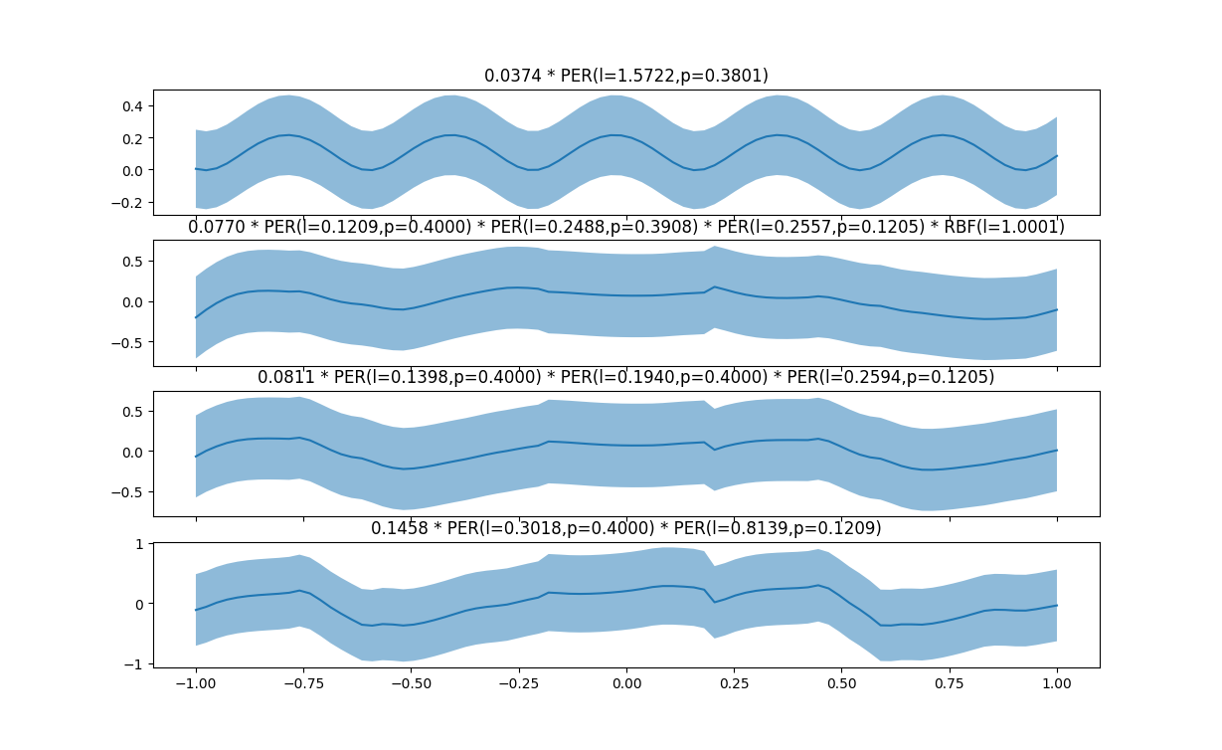
Autostat generated kernels
Lvl 6

Slide 43
Steps to test GP fitting for interaction matrix identification
GP Fitting, Predictions, cross-correlation
GP Fitting, kernel analysis
GP Fitting, constraining with interaction matrix for hyper-parameter tuning
Designing kernels for gMLV for GP Fitting
GP for Network Identification (work with Marc)

Slide 44
1. GP Fitting, Predictions, cross-correlation

Slide 45
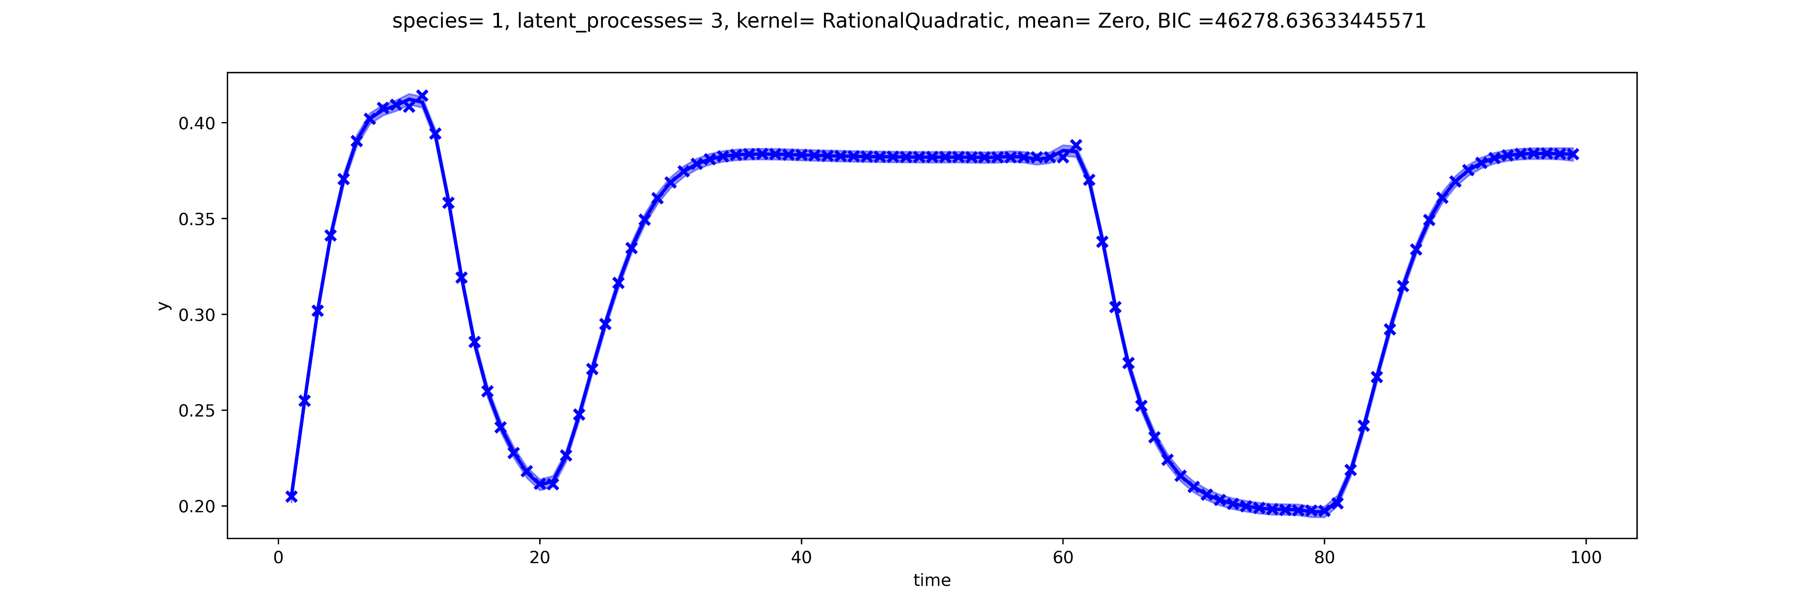
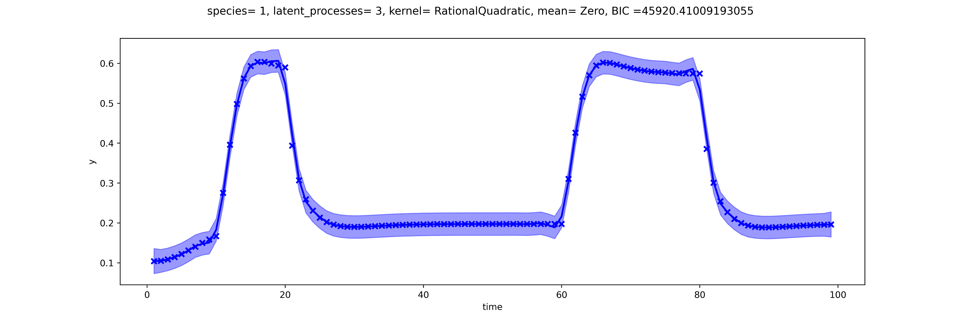
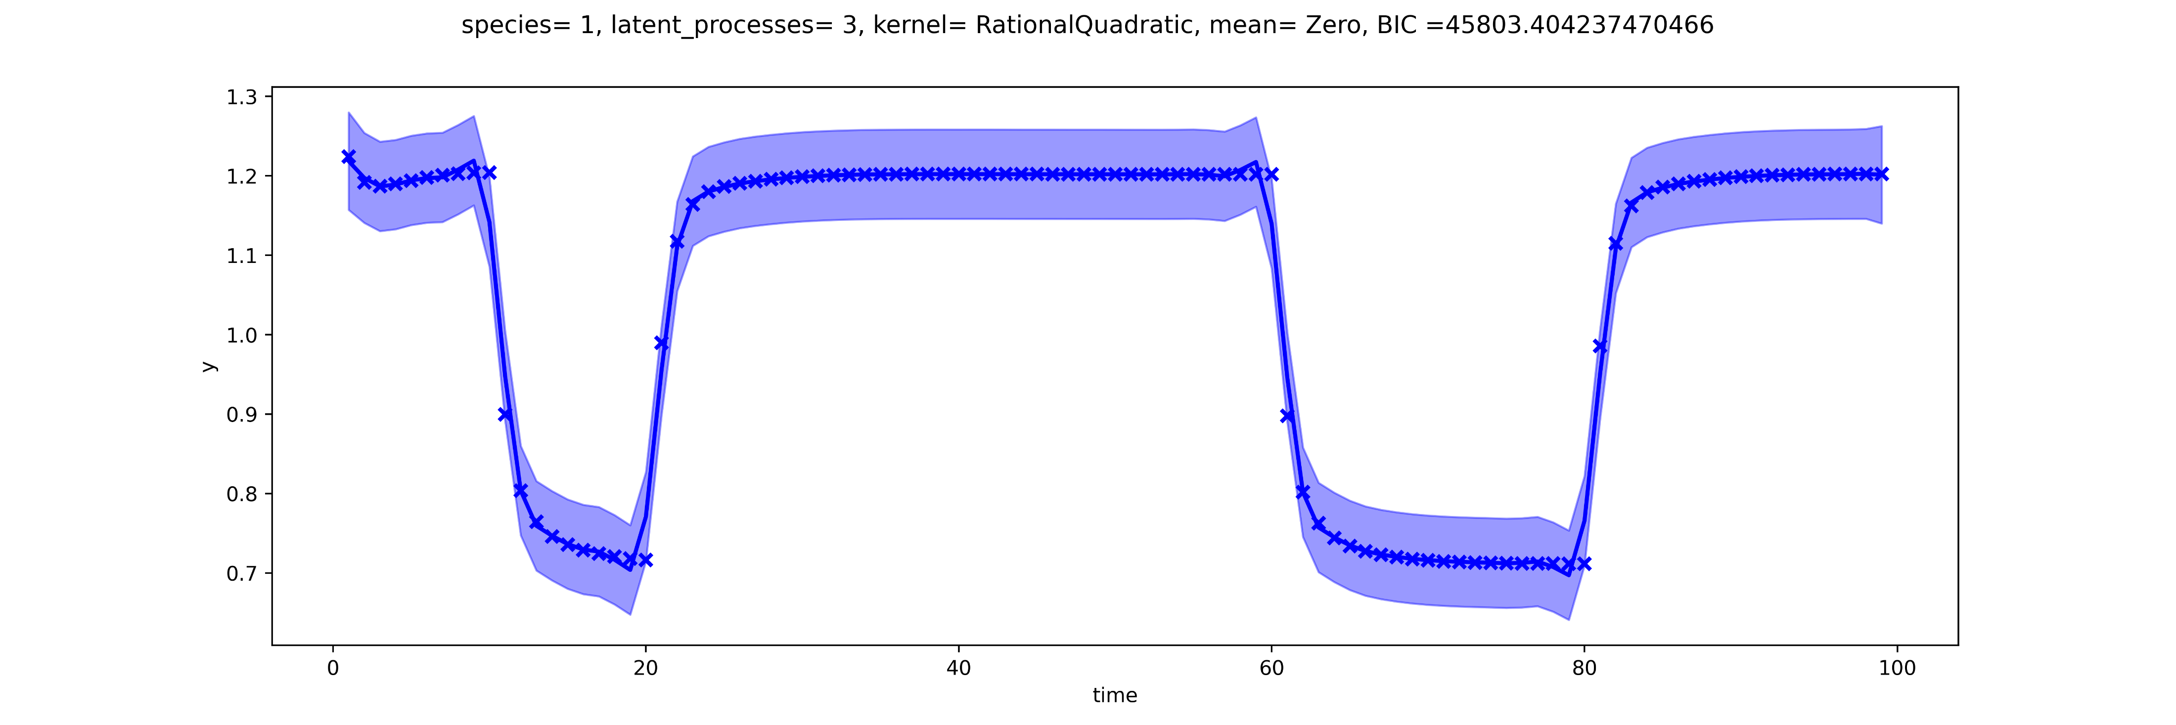
GP fitting using gMLV simulations
Using VGP for gaussian processes
Notes:
This fits where done as independent fits (meaning, there is a GP regression fit for each curve) instead of doing the 3 simultaneously as done previously.
USES ALL POINTS instead of sampled (or observed)

Slide 46
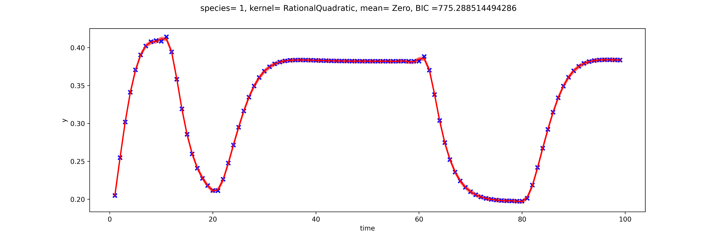
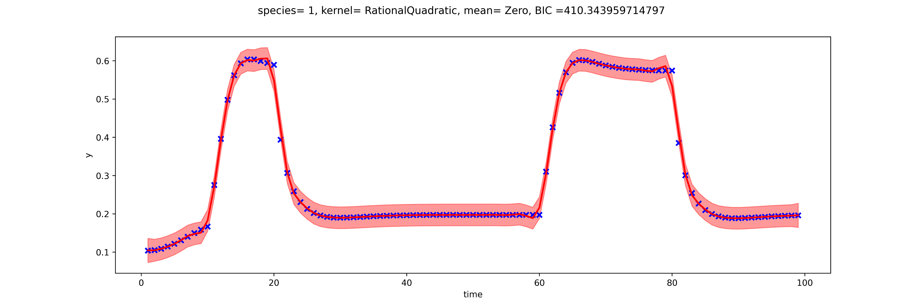
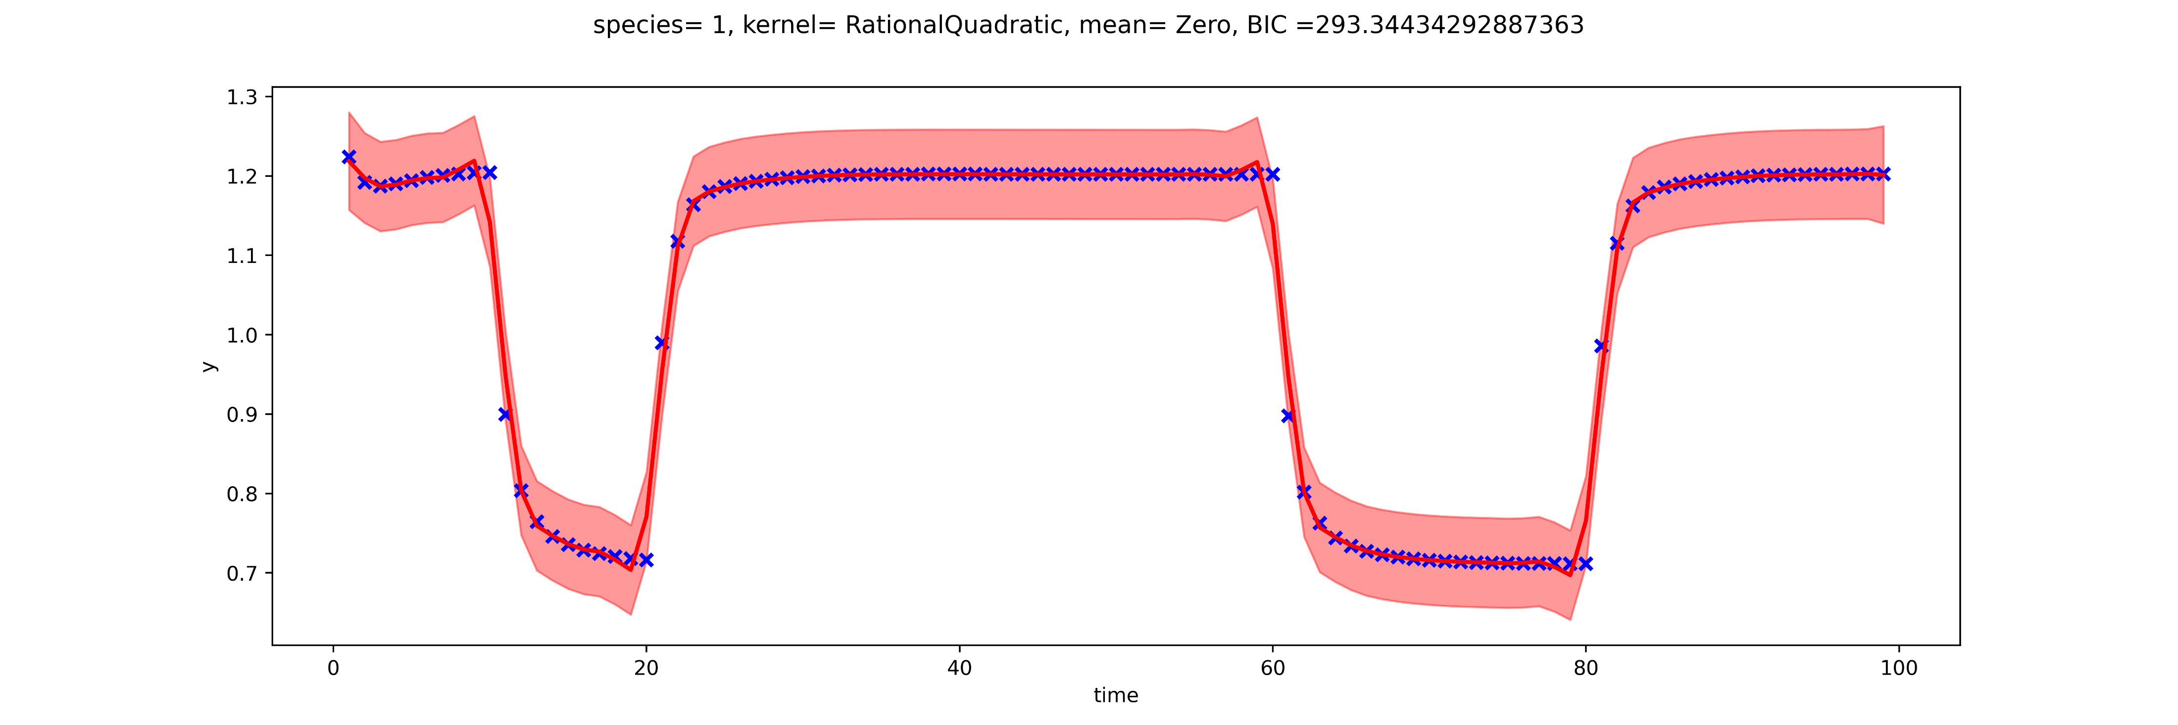
GP fitting using gMLV simulations
Same as before, but using GPR instead of VGP
Notes:
This fits where done as independent fits (meaning, there is a GP regression fit for each curve) instead of doing the 3 simultaneously as done previously.
USES ALL POINTS instead of sampled (or observed)

Slide 47
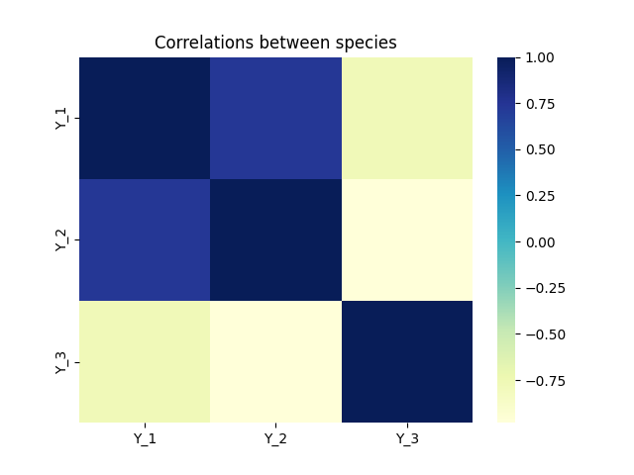
P-values for the correlations

Slide 48
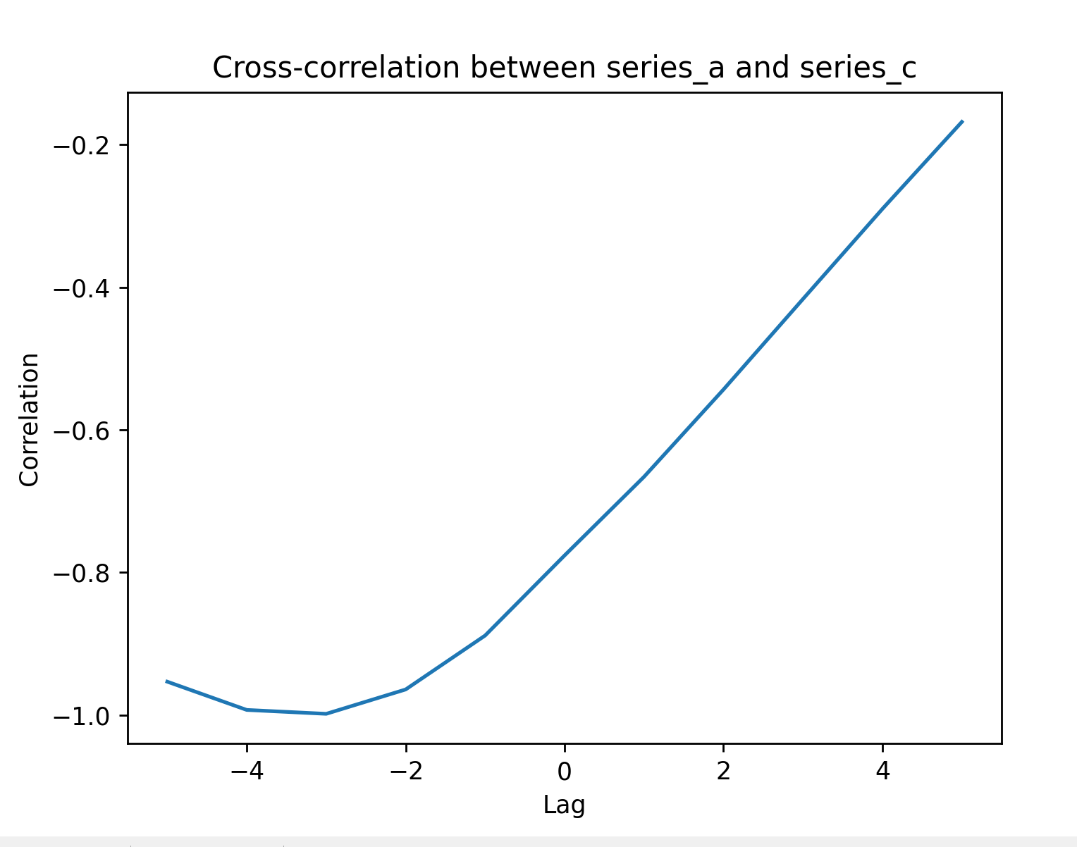
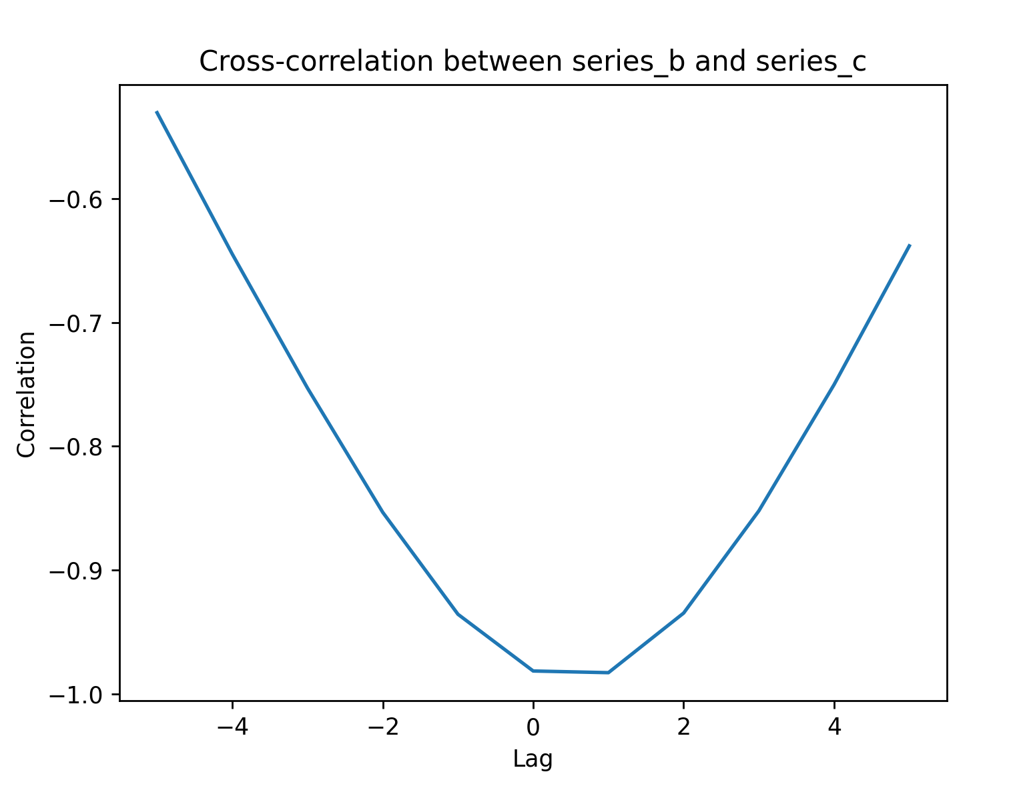
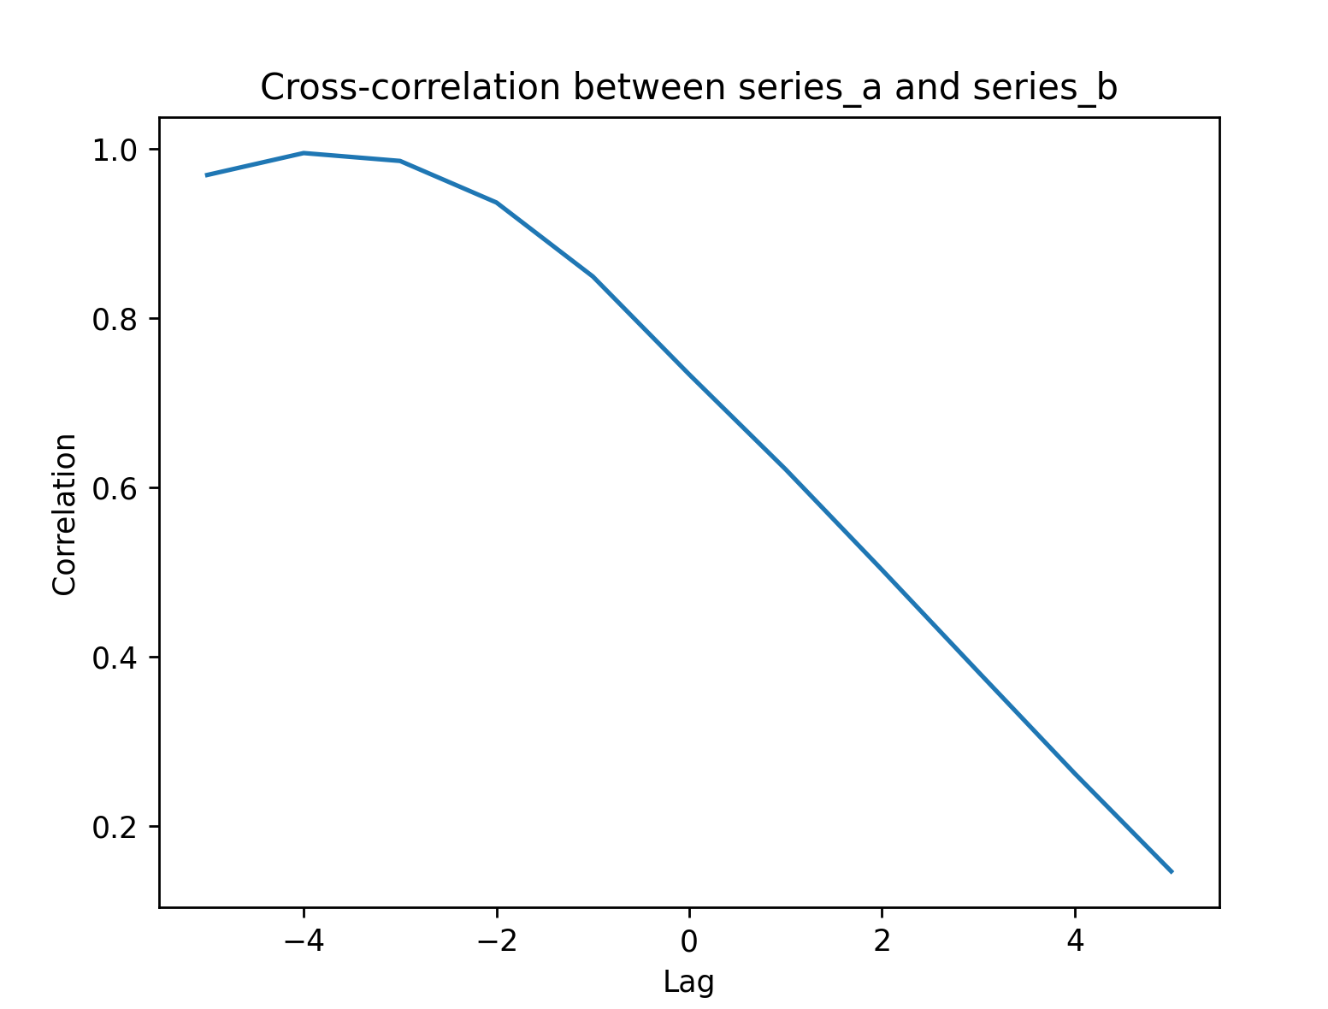
Cross-correlation with different lags

Slide 49
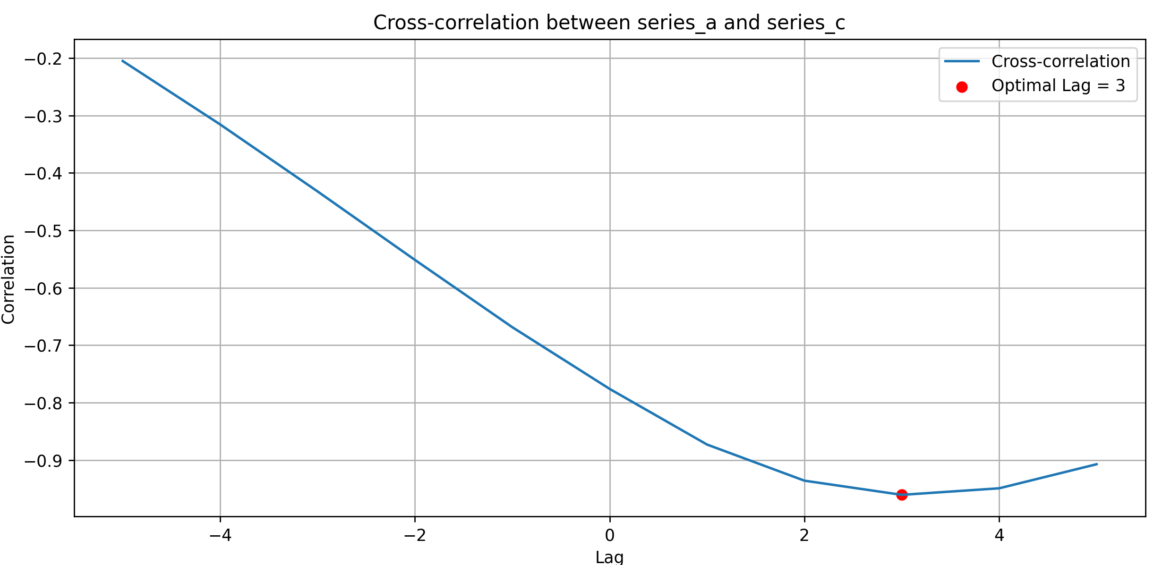
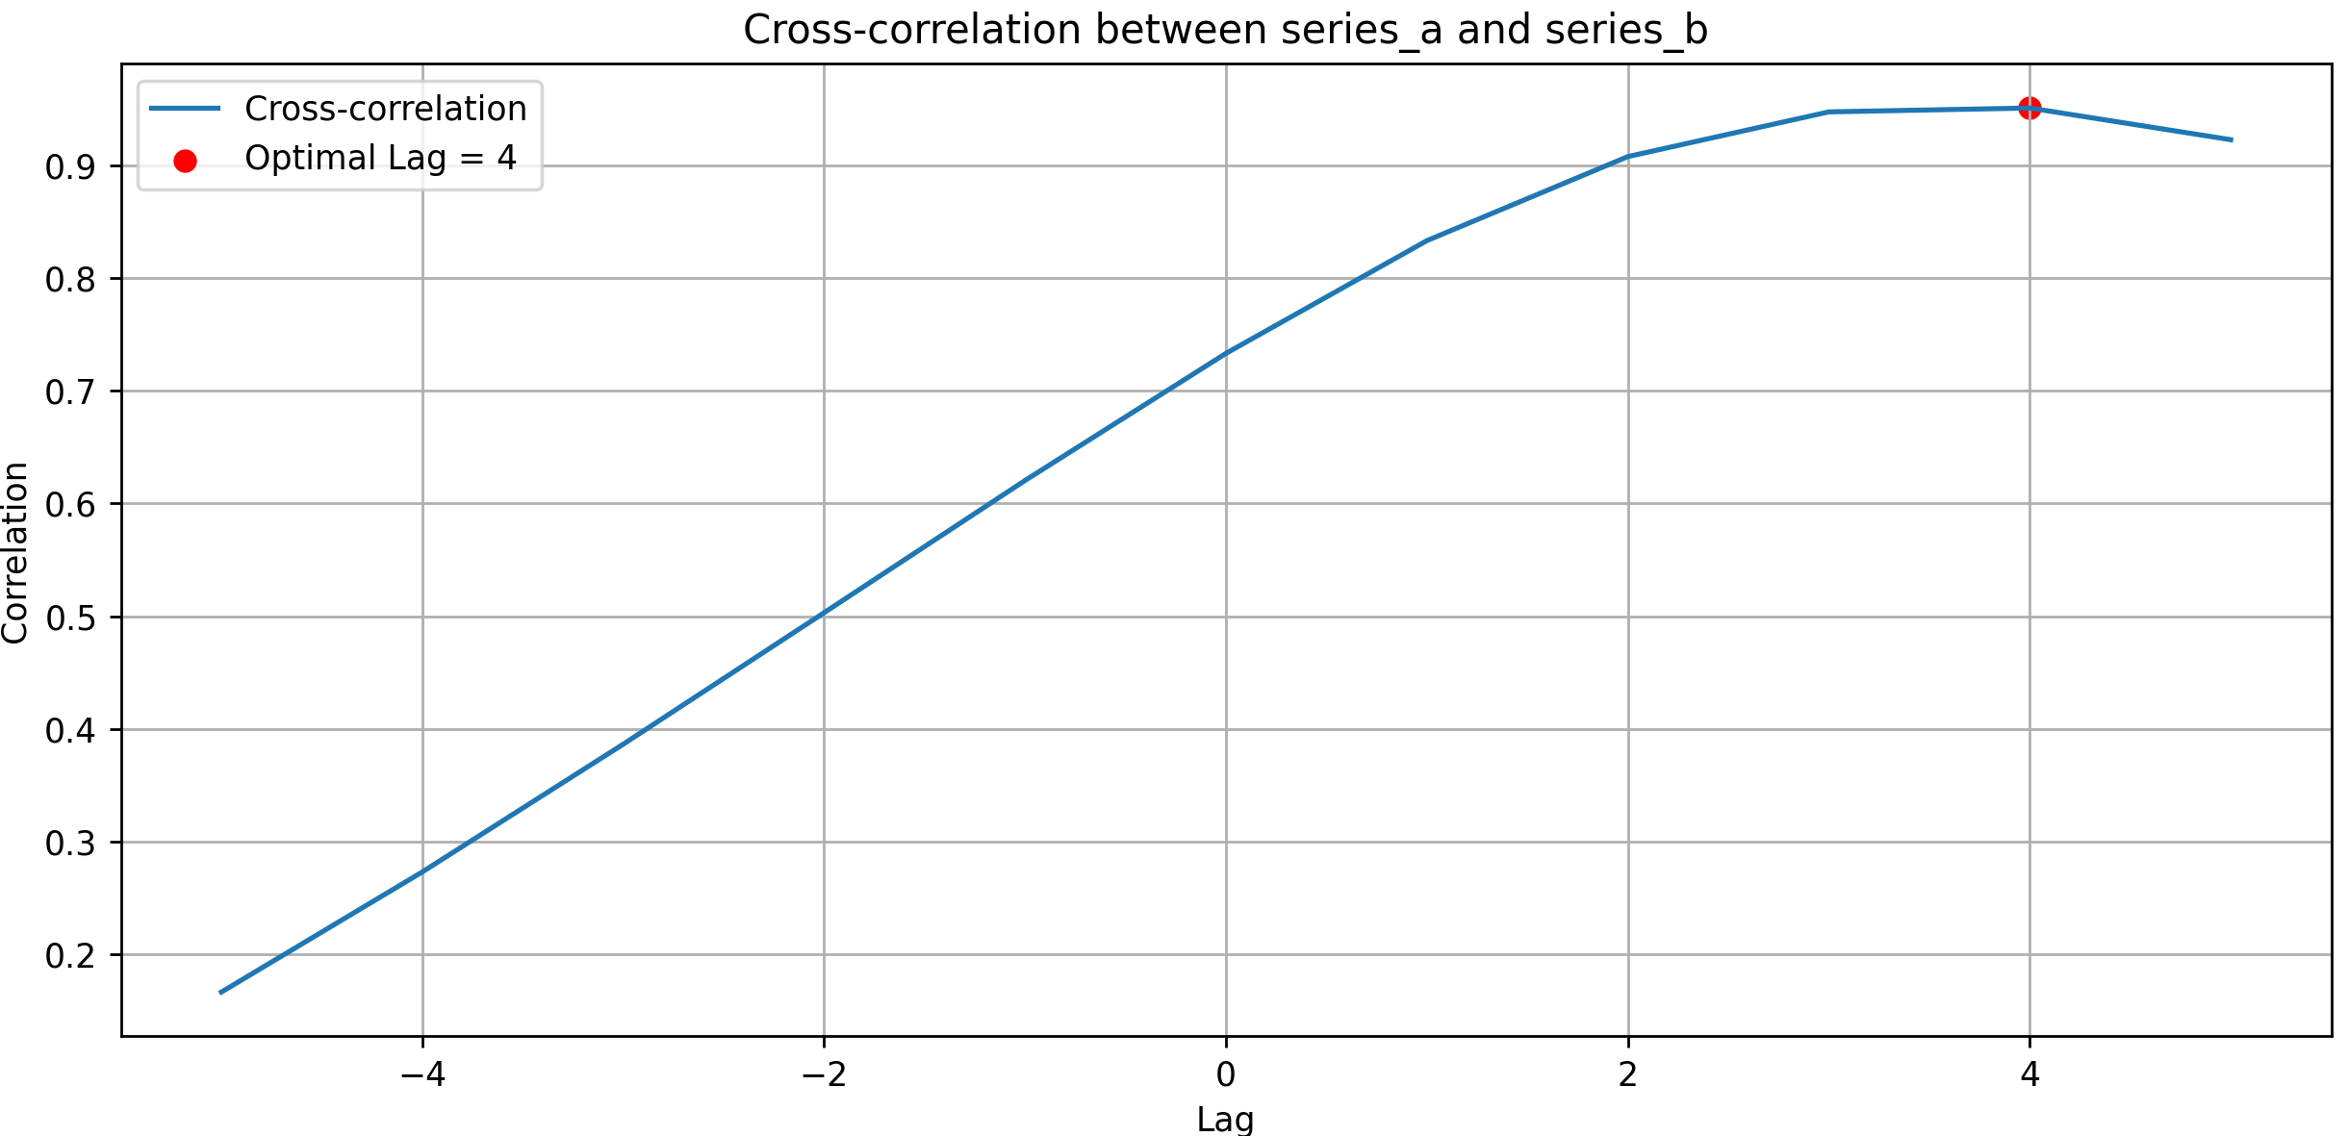
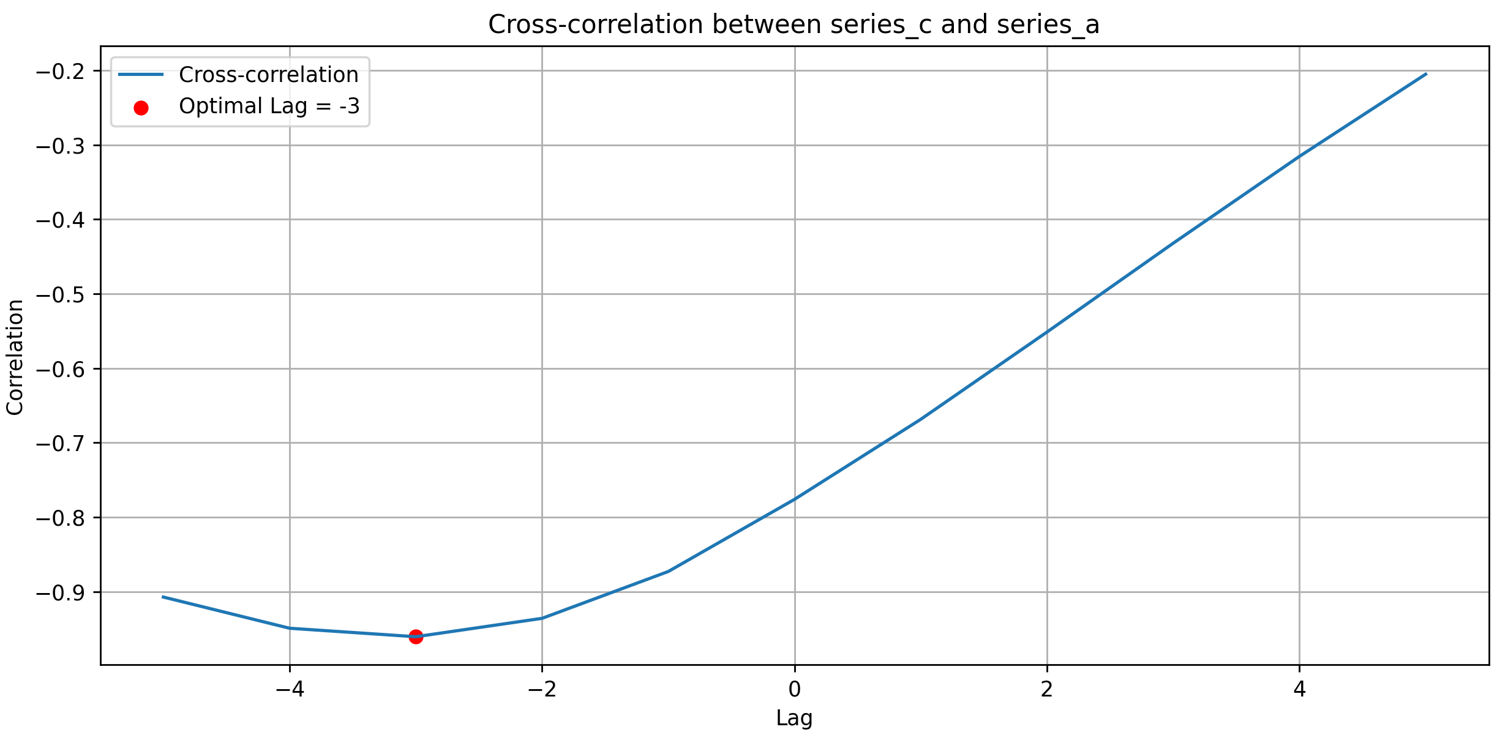
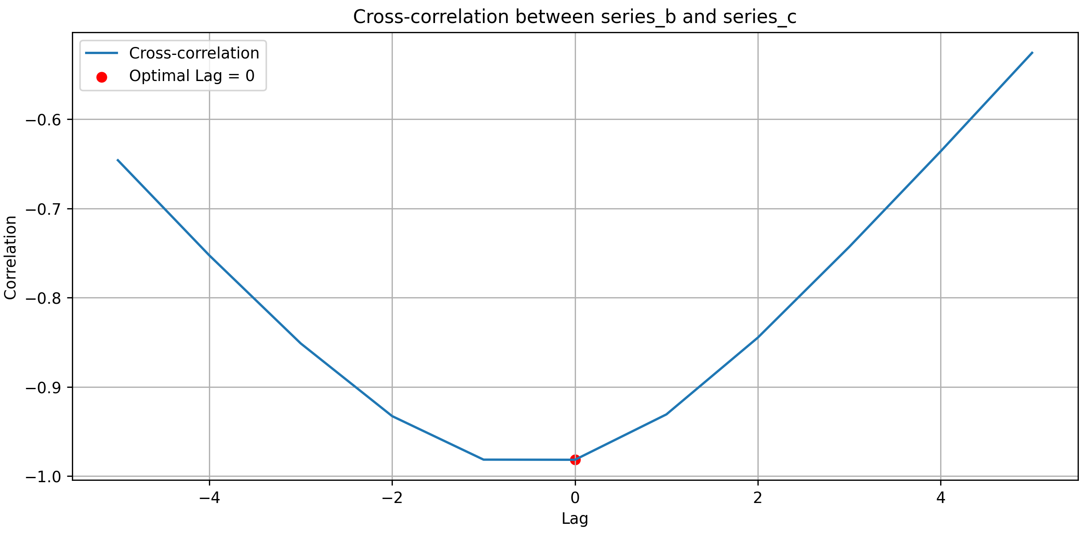
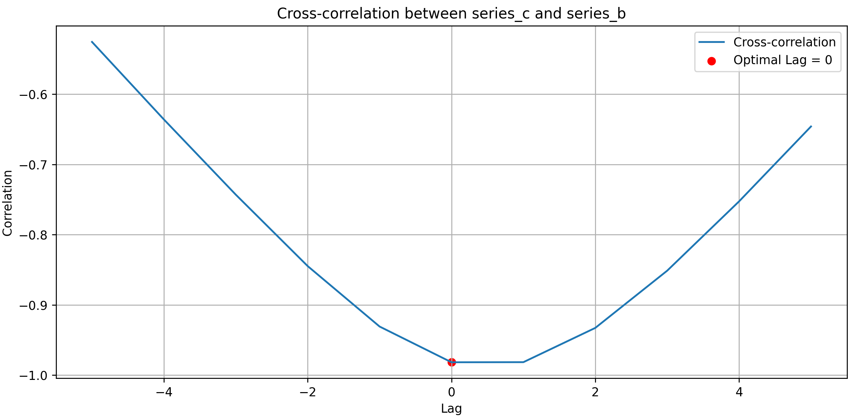

Notes:
Maybe do the following analysis with a fixed lag?

Slide 50


Comparison between interaction matrix and cross-correlation estimations
Interaction coefficient matrix
Cross-correlation estimations
Notes:
Given these matrices, let's make some observations:
1. **Diagonal Elements**: Both matrices have diagonal entries equal to 1. This is because the diagonal represents self-interaction in the interaction matrix and autocorrelation in the cross-correlation matrix.
2. **Magnitude**: The off-diagonal values in the interaction matrix are generally smaller in magnitude than those in the cross-correlation matrix. Cross-correlation values range from -1 to 1, indicating the strength and direction of linear relationships at the optimal lags. The interaction coefficients, on the other hand, denote direct influences and might not necessarily have values restricted to this range.
3. **Sign**:
- The interaction coefficient between series_a and series_c is negative (-0.7154), and the maximum cross-correlation at the optimal lag is also negative (-0.961), which suggests that the two series are inversely related, consistent with the interaction matrix.
- Similarly, for series_c with series_a, the interaction coefficient is positive (0.5468), and the maximum cross-correlation is negative (-0.961). This inverse relationship suggests that as one species increases, the other decreases with some delay.
- For series_a and series_b, the interaction coefficient is slightly negative (-0.0777), while the cross-correlation is positive (0.951). This discrepancy might be due to other interactions affecting series_b or potential nonlinearities not captured by simple cross-correlation.
4. **Strength of Relationships**: The magnitude of the cross-correlation values indicates strong relationships between the series at certain lags. However, these values don't directly map to the magnitude of interaction coefficients. For instance, a high cross-correlation doesn't necessarily mean a high interaction coefficient, and vice versa.
5. **Interactions and Lags**: The system of differential equations describes instantaneous interactions, while the cross-correlation values describe relationships at specific lags. The presence of a lag suggests that the effect of one species on another isn't immediate but takes some time to manifest. This delay might be due to various biological, ecological, or physical processes not explicitly modeled in the differential equations.
In conclusion, while there are some similarities in patterns between the two matrices (e.g., signs indicating inverse or direct relationships), direct one-to-one comparisons are tricky. The cross-correlation values provide insights into time-lagged associations between the series, while the interaction matrix represents instantaneous interactions. However, the observed patterns in the cross-correlation matrix can still provide valuable insights into the underlying interactions and guide further investigations or refinements of the model.

Slide 51
Next Steps
Use kernels obtained using the Automated GP algorithm to understand the underlying system or the relationship between species
Relate kernels to biological interactions/entities
Find common kernels between different time-series and compare
Develop method for GP regression for known systems using (next slide)
Develop method for GP regression for unknown systems

Slide 52
Gaussian Process Regression
Model Architecture
Prior
Kernels
Posterior
Kernel-based approach to Learning
- Simple Kernels
- Complex Kernels
Normal
GP-NFIR
GP-NARX
GP-NOE
state-space (GPSS)
Latent
Sparce
Variational
Autoregressive
Constraining solution space
ODE-constraining

Slide 53

Structure of a typical Gaussian process algorithm
Notes:
From: chrome-extension://efaidnbmnnnibpcajpcglclefindmkaj/http://eil.stanford.edu/publications/max_ferguson/gpr-representation-in-pmml.pdf

Slide 54

Structure of a typical Gaussian process algorithm
Notes:
From: chrome-extension://efaidnbmnnnibpcajpcglclefindmkaj/http://eil.stanford.edu/publications/max_ferguson/gpr-representation-in-pmml.pdf

Slide 55
Prior
Algorithm (auto-regressive, etc)
Kernels
Hyperparameter tuning
Likelihood

Slide 56
System Identification
System Identification
Network Inference
Causal Structure

